Slide 1
Malignant Comments Classifier
By
Girija Chandra Mohan

Slide 2
Introduction
The proliferation of social media enables people to express their opinions widely online. However, at the same time, this has resulted in the emergence of conflict and hate, making online environments uninviting for users. Although researchers have found that hate is a problem across multiple platforms, there is a lack of models for online hate detection. Online hate, described as abusive language, aggression, cyberbullying, hatefulness and many others has been identified as a major threat on online social media platforms. Social media platforms are the most prominent grounds for such toxic behavior.
There has been a remarkable increase in the cases of cyberbullying and trolls on various social media platforms. Many celebrities and influences are facing backlashes from people and have to come across hateful and offensive comments. This can take a toll on anyone and affect them mentally leading to depression, mental illness, self-hatred and suicidal thoughts.

Slide 3
Dataset description
The data set contains the training set, which has approximately 1,59,000 samples and the test set which contains nearly 1,53,000 samples. All the data samples contain 8 fields which includes ‘Id’, ‘Comments’, ‘Malignant’, ‘Highly malignant’, ‘Rude’, ‘Threat’, ‘Abuse’ and ‘Loathe’.
The label can be either 0 or 1, where 0 denotes a NO while 1 denotes a YES. There are various comments which have multiple labels. The first attribute is a unique ID associated with each comment.
The data set includes:
- Malignant: It is the Label column, which includes values 0 and 1, denoting if the comment is malignant or not.
- Highly Malignant: It denotes comments that are highly malignant and hurtful.
- Rude: It denotes comments that are very rude and offensive.
- Threat: It contains indication of the comments that are giving any threat to someone.
- Abuse: It is for comments that are abusive in nature.
- Loathe: It describes the comments which are hateful and loathing in nature.
- ID: It includes unique Ids associated with each comment text given.
- Comment text: This column contains the comments extracted from various social media platforms

Slide 4
Conceptual Background of the Domain Problem
Online platforms and social media become the place where people share the thoughts freely without any partiality and overcoming all the race people share their thoughts and ideas among the crowd.
Social media is a computer-based technology that facilitates the sharing of ideas, thoughts, and information through the building of virtual networks and communities. By design, social media is Internet-based and gives users quick electronic communication of content. Content includes personal information, documents, videos, and photos. Users engage with social media via a computer, tablet, or smartphone via web-based software or applications.
While social media is ubiquitous in America and Europe, Asian countries like India lead the list of social media usage. More than 3.8 billion people use social media.
In this huge online platform or an online community there are some people or some motivated mob wilfully bully others to make them not to share their thought in rightful way. They bully others in a foul language which among the civilized society is seen as ignominy. And when innocent individuals are being bullied by these mob these individuals are going silent without speaking anything. So, ideally the motive of this disgraceful mob is achieved.
To solve this problem, we are now building a model that identifies all the foul language and foul words, using which the online platforms like social media principally stops these mob using the foul language in an online community or even block them or block them from using this foul language.

Slide 5
MODEL BUILDING STEPS
1. Data Cleaning
2. Exploratory Data Analysis
3. Data Pre-processing
4. Model Building
5. Model Evaluation
6. Selecting the best model

Slide 6
Data preprocessing
1. Load dataset
2. Remove null values
3. Drop column id
4. Convert comment text to lower case and replace '\n' with single space.
5. Keep only text data ie. a-z' and remove other data from comment text.
6. Remove stop words and punctuations
7. Apply Stemming using SnowballStemmer
8. Convert text to vectors using TfidfVectorizer
9. Load saved or serialized model
10. Predict values for multi class label

Slide 7
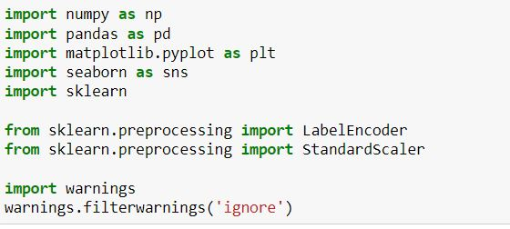
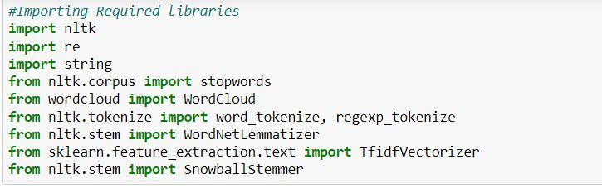
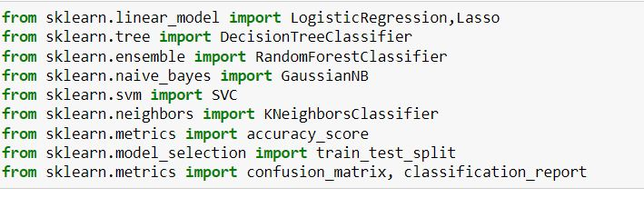
Imported Libraries

Slide 8
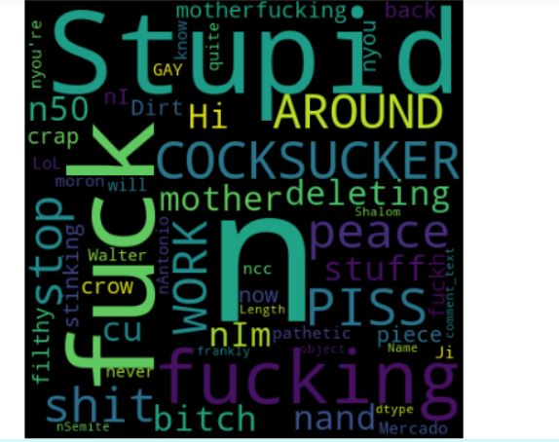
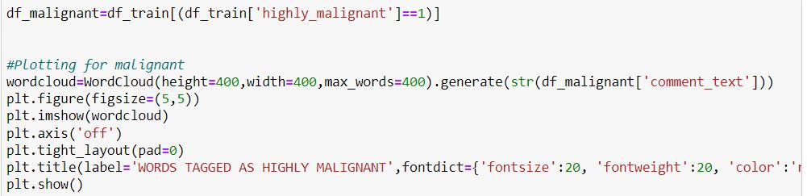
Analytical Problem Framing

Slide 9
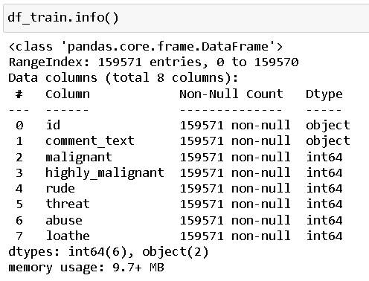
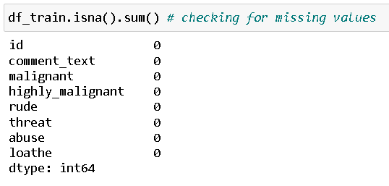

Slide 10


Then we went ahead and performed multiple data cleaning and data transformation steps. I have added an additional column to store the original length of our comment_text column

Slide 11
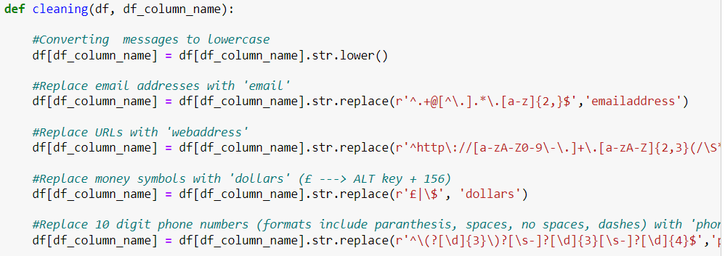
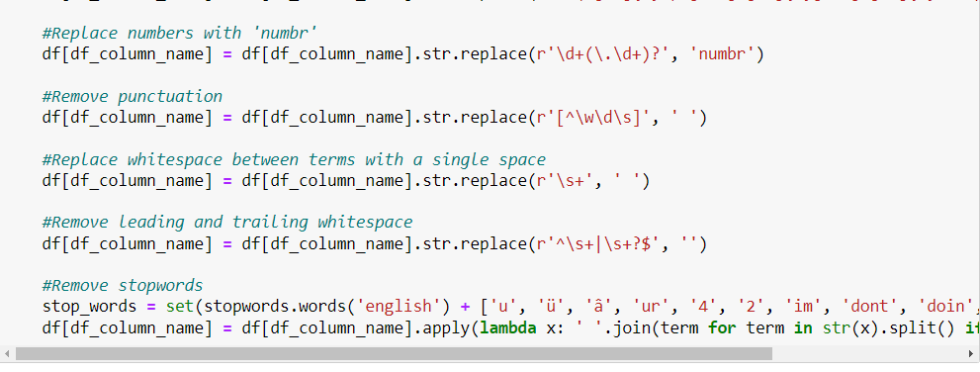
Data Cleaning
Stemming is the process of reducing a word to its word stem that affixes to suffixes and prefixes or to the roots of words known as a lemma. Stemming is important in natural language understanding (NLU) and natural language processing (NLP).

Slide 12
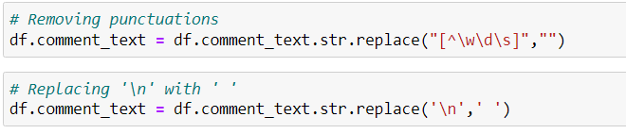
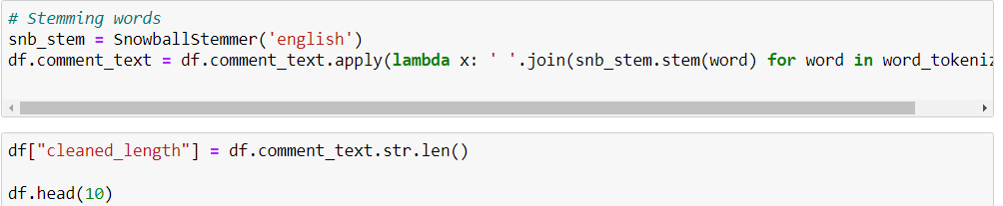

Slide 13
Testing of Identified Approaches (Algorithms)
The complete list of all the algorithms used for the training and testing classification model are listed below:
Logistic Regression
Random Forest Classifier
SVC
K Nearest Neighbors Classifier
Decision Tree Classifier
Run and Evaluate selected models
I created a classification function that included the evaluation metrics details for the generation of our Classification Machine Learning models.

Slide 14
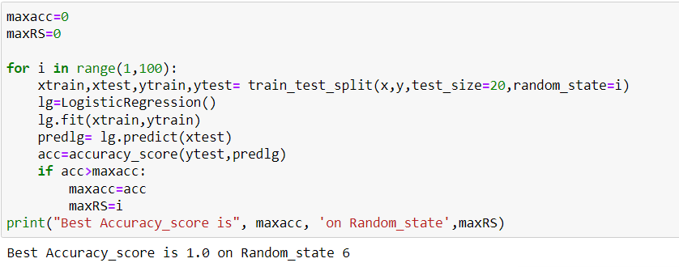
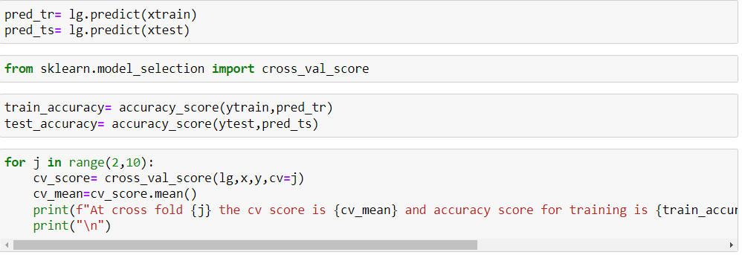

Slide 15
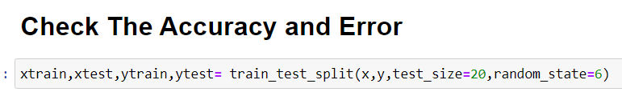
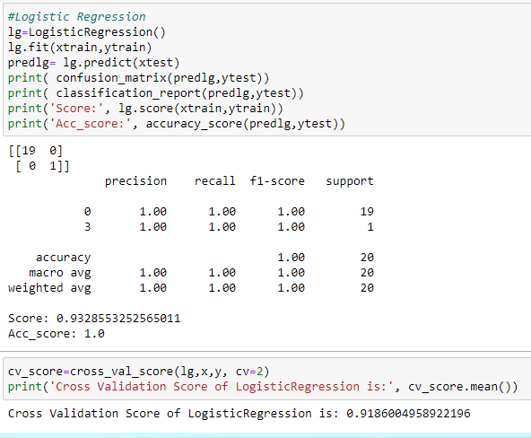
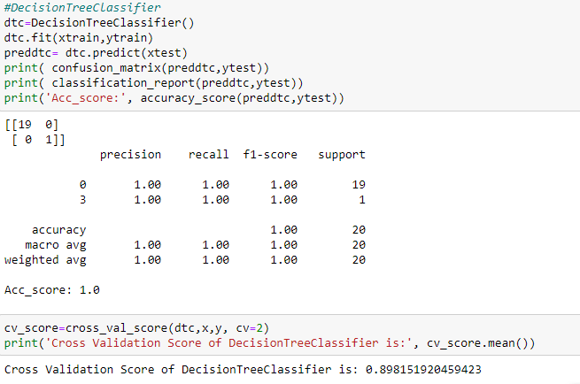

Slide 16
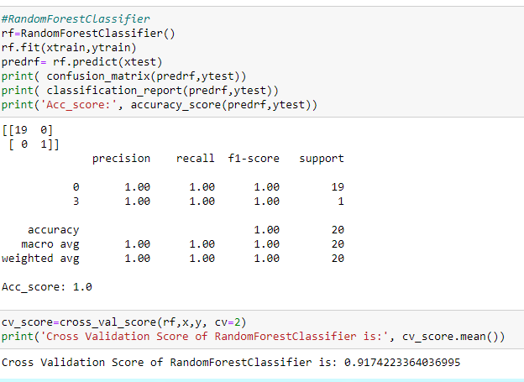
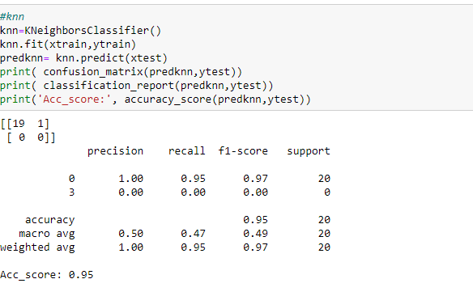

Slide 17
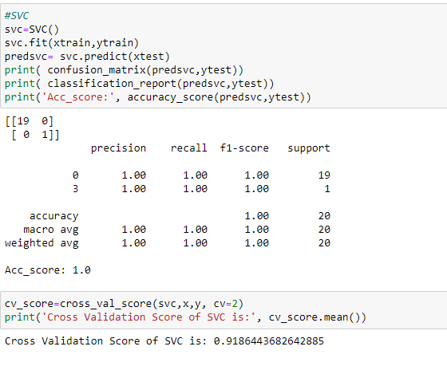
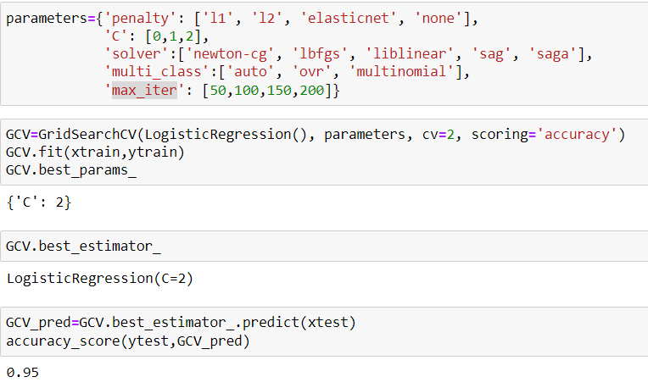
Hyper Parameter Tuning

Slide 18
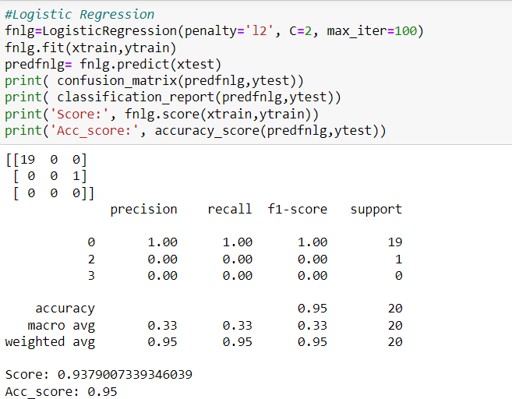
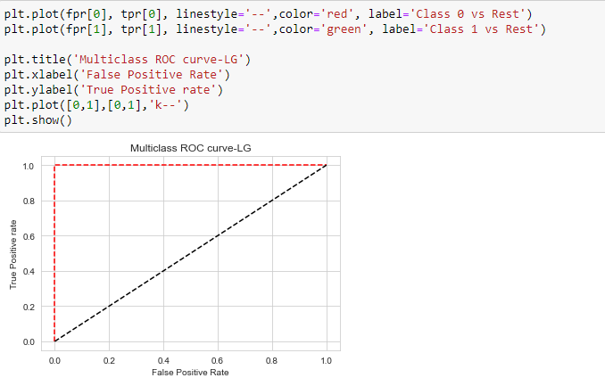
Final Model
ROC Curve

Slide 19
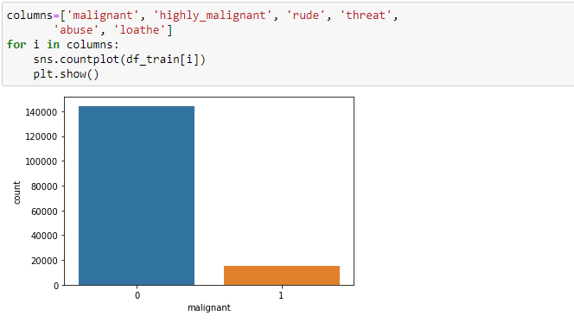
Visualizations
I used the pandas profiling feature to generate an initial detailed report on my dataframe values. It gives us various information on the rendered dataset like the correlations, missing values, duplicate rows, variable types, memory size etc. This assists us in further detailed visualization separating each part one by one comparing and research for the impacts on the prediction of our target label from all the available feature columns.

Slide 20
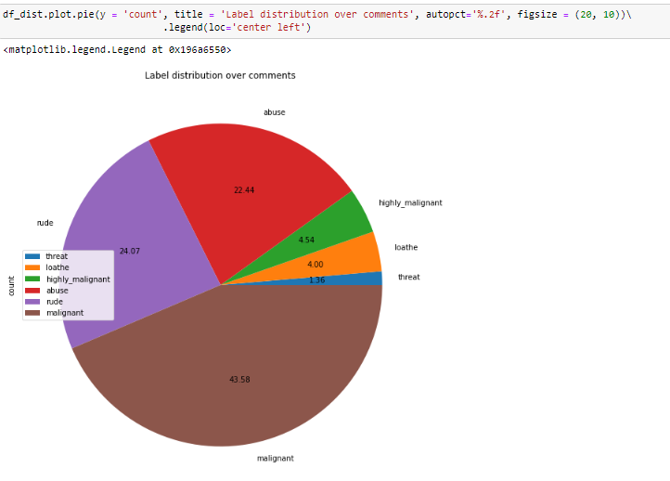

Slide 21
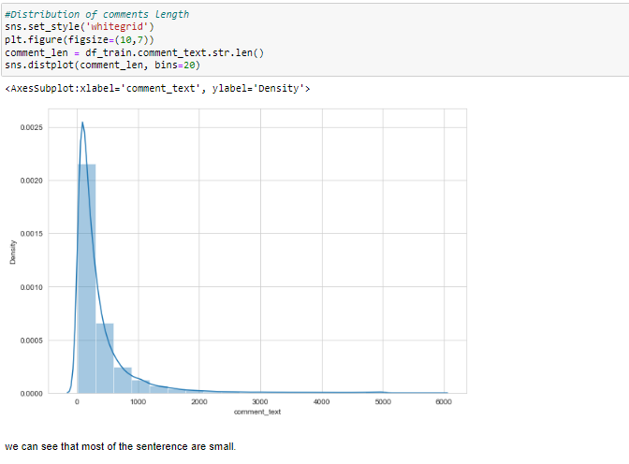
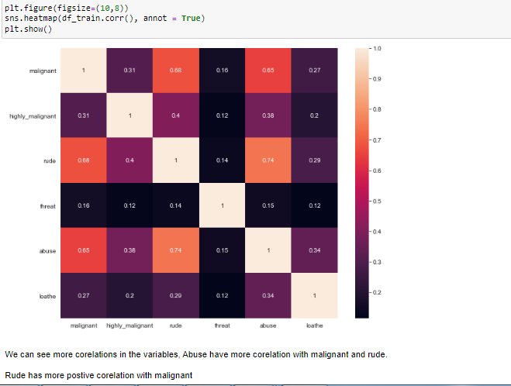

Slide 22
Key Findings and Conclusions of the Study
The finding of the study is that only few users over online use foul language. And most of these sentences have more stop words, and are being long. As discussed before few motivated disrespectful crowds uses these foul languages in the online forum to bully the people around and to stop them from doing the things that they are suppose to do. Our Study helps the online forms and social media to induce a ban to profanity or usage of profanity over these forms.

Slide 23
Learning Outcomes of the Study in respect of Data Science
I have developed our system based on a foul language classification approach; it is based on an improved version of a Logistic Regression Algorithm that detects offensive language usage in a conversation. As per our evaluation, we found that lesser number of users conversation is not decent all the time. We trained 159571 observations for eight context categories using a Logistic Regression algorithm for context detection. Then, the system classifies the use of foul language in one of the trained contexts in the text conversation. In our testbed, we observed 10% of participants used foul language during their text conversation. Hence, our proposed approach can identify the impact of foul language in text conversations using a classification technique and emotion detection to identify the foul language usage

Slide 24
Limitations of this work and Scope for Future Work
The limitation of the study is that we have a imbalanced data so our model learnt more about the non-abusive sentence more than the abusive sentence. Which makes our model act like a overfit model when tested with live data. And also, model tend to not identify a foul or a sarcastically foul language.

Slide 25
Thank you

